Slide 1
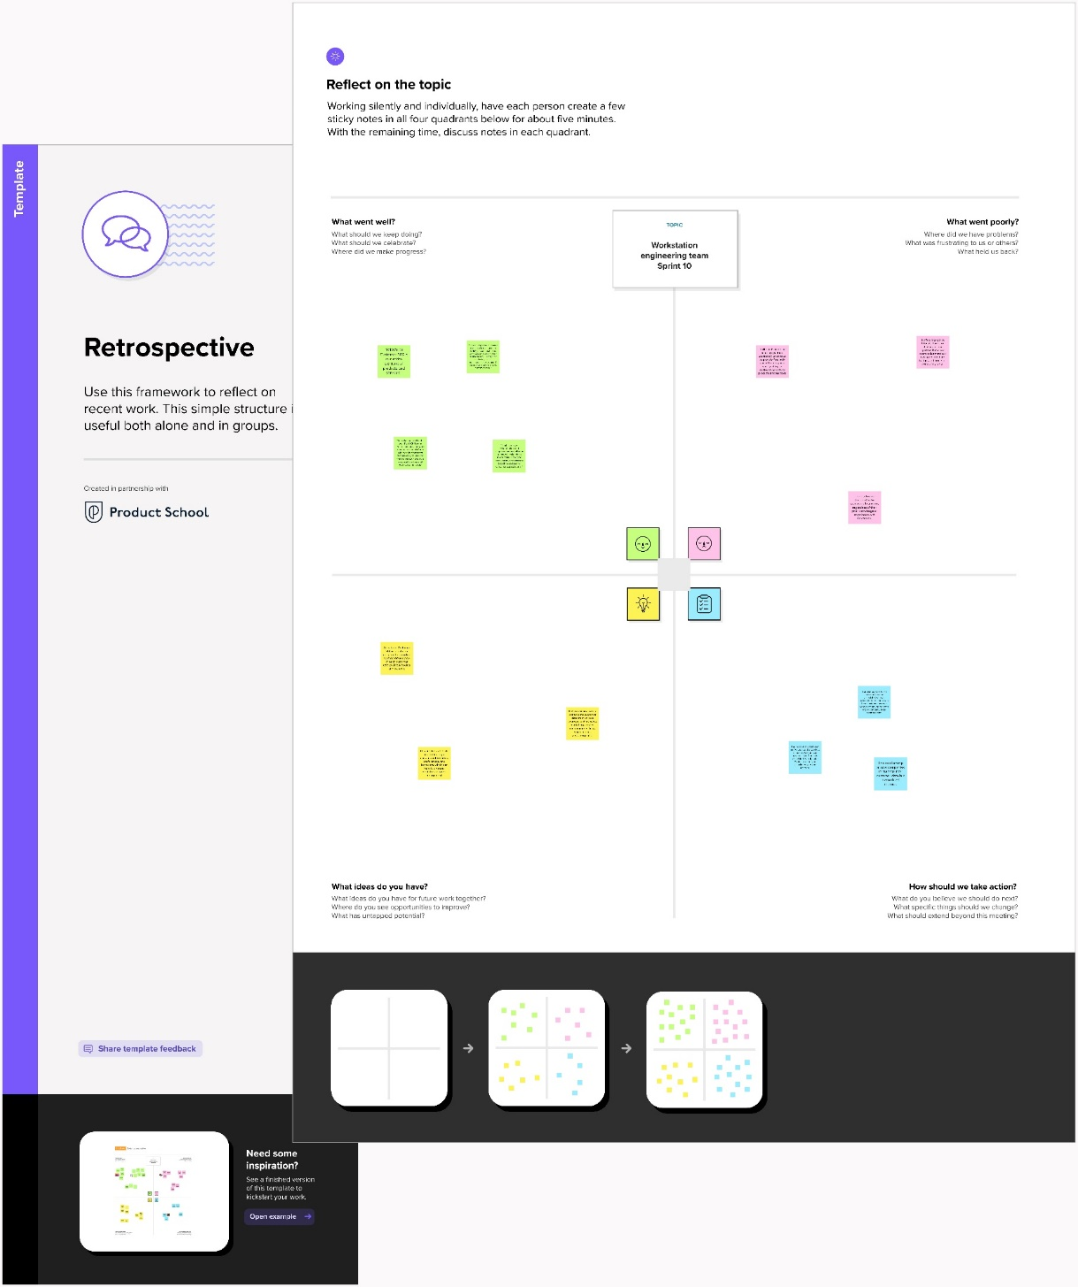
CRM APPLICATION THAT HELPS TO BOOK A VISA SLOT
INTRODUCTION
  Overview
A visa slot management project is a system that is used to track and manage the availability of visa slots, which are appointments that are required for certain visa applications. It might be used by a government agency or a visa processing center to schedule and manage appointments with applicants..
  Purpose
Track and manage the availability of visa slots, which are appointments that are required for certain visa applications.
Problem Definitions & Design Thinking
  Empathy Map
2.2 Ideation & Brainstorming Map

Slide 2
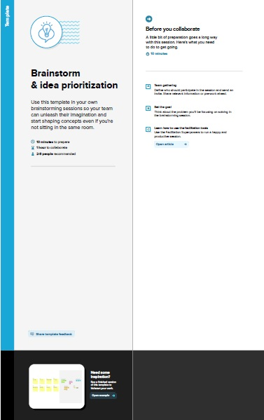

Slide 3
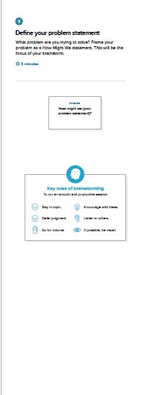

Slide 4
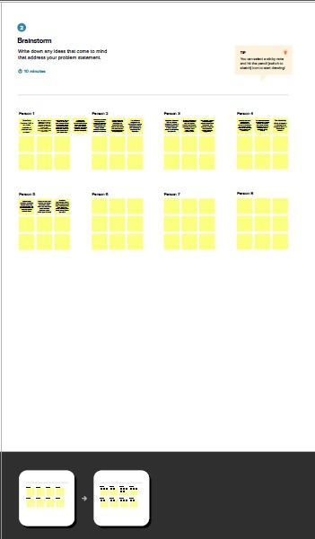
3 Result

Slide 5
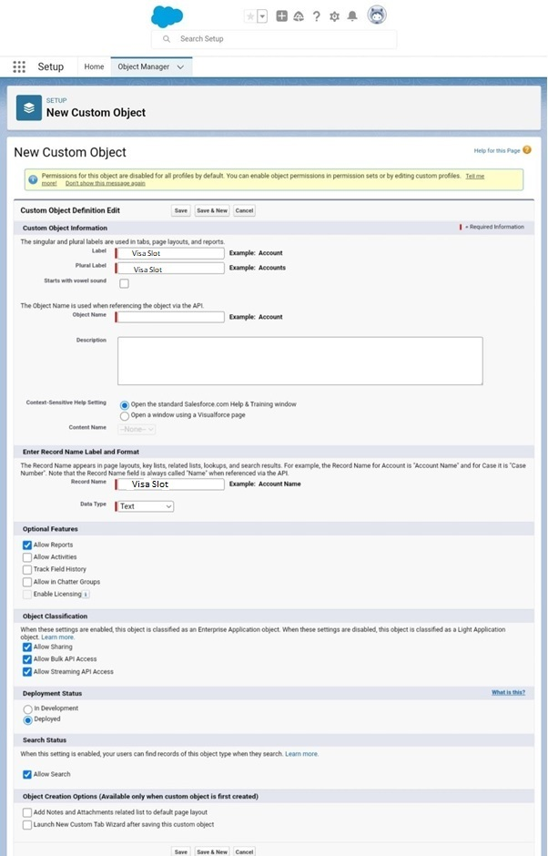

Slide 6
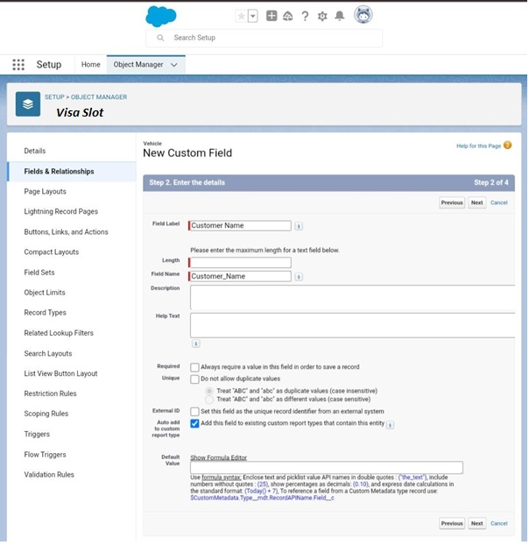
A CRM gathers customer interactions across all channels in one place. Managing centralized data helps businesses improve customer experience, satisfaction, retention and service.CRM allows businesses of all sizes to drive growth and profits.

Slide 7
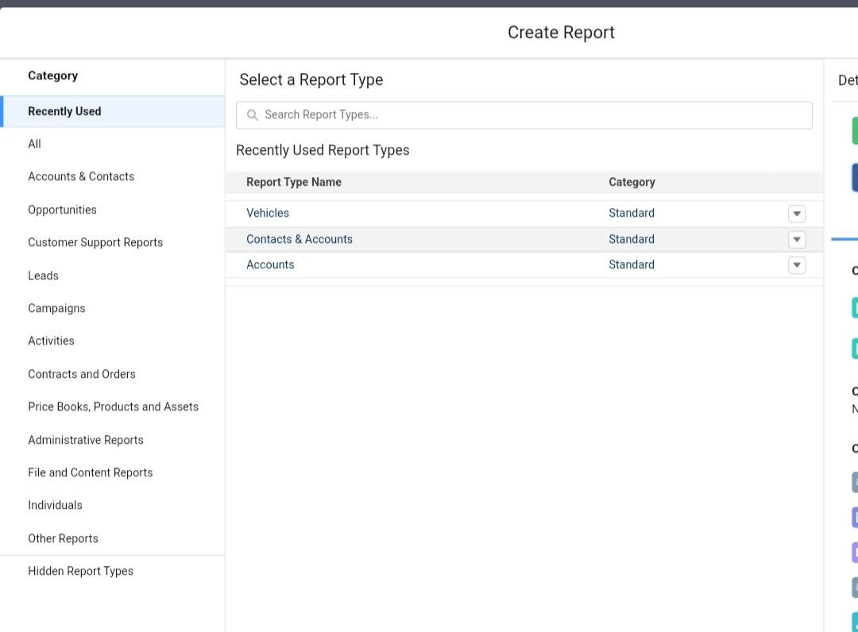
Analytical CRM tools make your data available, intelligible, and relevant to your business needs. All your heaps of sales data, finance data, and marketing data flow into CRM to become visible metrics, with data warehousing and data mining there to make sense of everything. The net benefit is customer acquisition, customer retention, and better data management.
Start repot and enter the datas.
Then save and run.

Slide 8
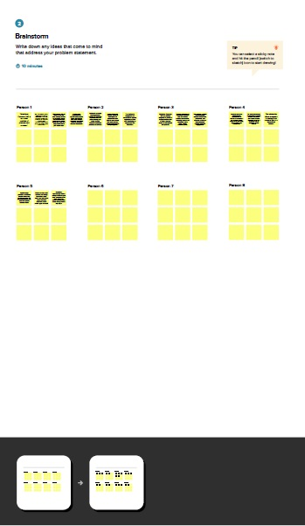

Slide 9
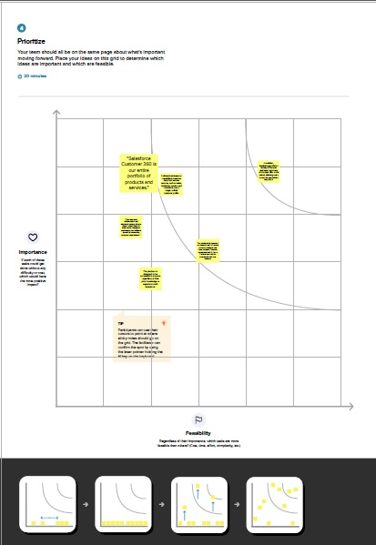

Slide 10
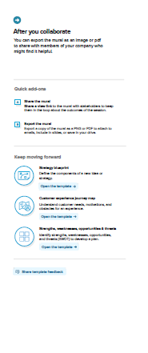

Slide 11
Traihead Profile Public URL
Team Lead : https://trailblazer.me/id/jana2908
Team Member 1 : https://trailblazer.me/id/mydeen
Team Member 2 : https://trailblazer.me/id/sivakumar2309
Team Member 3 : https://trailblazer.me/id/maharajan2002
Team Member 4 : https://trailblazer.me/id/velmurugan1202
Advantages
Agents collect user credentials to book a visa slot.
As agents have access to multiple login accounts, they can log in multiple times using multiple user accounts
As soon as the visa slots are available, they book them and book for their other clients.
Disadvantage
Several Indian students trying to book appointments for US visas took to Twitter on Monday to complain that the website had locked them out for up to 72 hours after they refreshed its appointments page, and that the site had crashed after being unable to handle the load.
Applications
Marketing and sales force automation, contact and project management—these are the bread and butter features of a CRM system
Streamlining and improving the sales process, building a sales pipeline, automating tasks, and analyzing your sales data will inevitably lead to one outcome—increased sales and sales productivity
VISA SLOTS BOOKING
  Your passport number
  The date you paid your fee
  The ten (10) digit barcode number from your DS-160 confirmation page
Future Scope
Install the extension.
In case ofany damages and problem of vehicle that will claim by parking Go to
you can start from the login page, or else on the dashboard, click on Start to move to the search page
This extension will automate the booking process. You can do it on the options page if you need some cities except for booking.

